Slide 1
No Excuses -
Creating Employee Accountability

Slide 2
Do You Agree?
Accountability is more of a leadership problem then an employee problem.
Accountability is usually viewed as something negative that happens when things go wrong or as a punishment for mistakes.
Whenever people blame other people, places and things; you have an accountability problem.
Blame inhibits corrective action and undermines learning.
Negative accountability never works over the long term.
Accountability should be viewed as a powerful, positive and enabling principle that provides the foundation to build both individual and company success.
It is only when you build a culture of positive accountability that you have people who can and will achieve game-changing results.

Slide 3
Big Picture - Questions
How important is accountability in the workplace?
Poor Cultural Accountability Leads to:
Center for Academic Integrity Study
50,000 students surveyed at 83 colleges
70% - students admitted to cheating
41% - faculty members that were aware and did nothing
In the 1980’s, America CIA agent Aldrich Ames sold US government secrets to the Soviet KGB. His actions can be traced in part to the CIA’s fundamental inability to hold employees accountable for their performance.
Questionable Ethics
Lack of Trust
Missed Deadlines
Poor Performance
Chronic Efficiencies
Poor Customer Satisfaction
Poor Safety
Accountability in the workplace?
Gallup Study – 47,000 employees in 120 countries around the world
11% of workers worldwide are engaged (emotionally connected to their workplace and feel they have the resources and support they need to succeed)
62% are not engaged (emotionally detached and likely to be doing little more than is necessary to keep their jobs)
27% are actively disengaged (they view their work-places negatively and are liable to spread that negativity to others)

Slide 4
Organization - Questions
Does your organization set the tone for positive accountability?
Are leaders in your organization accountable to the employees?
Do employees trust your top management?
Are employees given credit for their successes more than they are held accountable for their errors?
employees
management

Slide 5
Individual - Questions
Do you think you are accountable?
Do you think others perceive you as being accountable?
Accountability Assessment Exercise

Slide 6
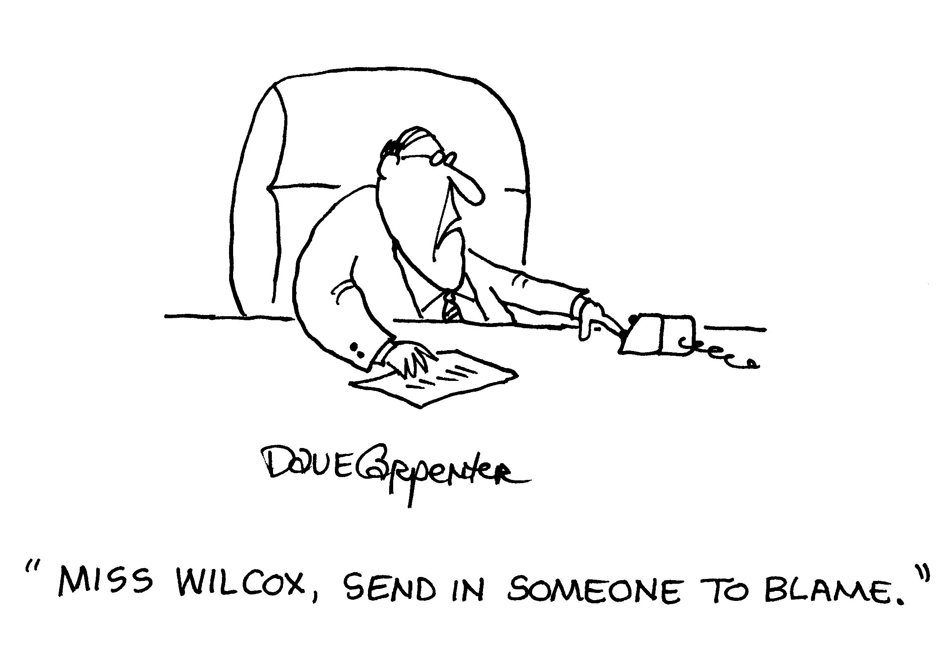

Slide 7
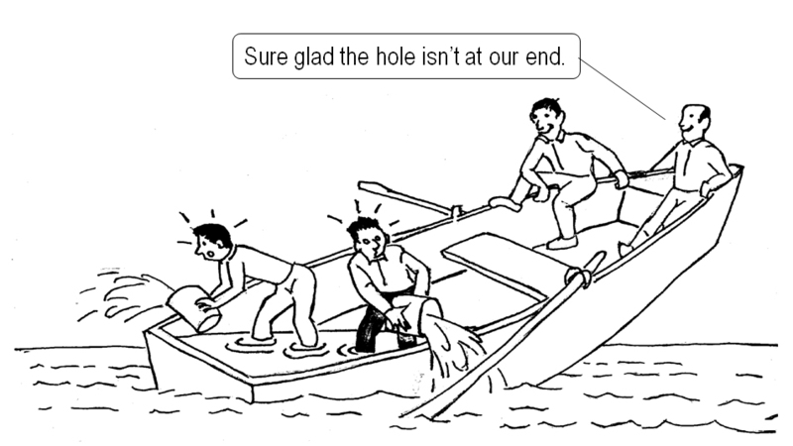
Spotting Lack of Accountability
In all workplaces, there is a vast library of creative excuses.
I don’t have enough time.
If only we had adequate staff (resources, etc.).
That’s not my job.
The staff can’t be trusted / are incompetent.
I don’t know how, anyway the boss didn’t say that.
Instead of focusing on why it can’t be done or wasn’t done, turn your attention to “what else can we do?”.

Slide 8
Obstacles Creating an Accountability Culture
Obstacles leaders face trying to improve accountability in their organization:
Measurements. Sometimes what’s easy to measure isn’t important to measure. Many people confuse correlation with causality putting to much faith in the numbers.
Fear of failure. You must allow for mistakes and adjustments. When failure is punished people stop trying.
Distress over lack of control. When people don’t trust others in the organization, they won’t participate in an accountability plan that depends on others.
Lack of commitment on both sides. When the request isn’t important enough to go to the top of the priority list or they don’t follow through.
Uncertainty of Consequences. It’s difficult to accept responsibility for something when the outcome is less certain to predict.
Results. If you focus only on results, it’s easy for people to achieve the end by any means necessary. This opens the door to ethical, reputational, legal and safety obstacles.

Slide 9

Results Oriented Public Transportation
While waiting for a bus one day I noticed several drive by that were for the most part empty. I ended up taking a taxi to my appointment, I asked the taxi driver about the empty buses. It turns out the drivers have a schedule to meet and are rewarded for getting back on time. When they’re behind schedule, the simply eliminate stops.

Slide 10
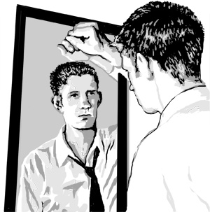
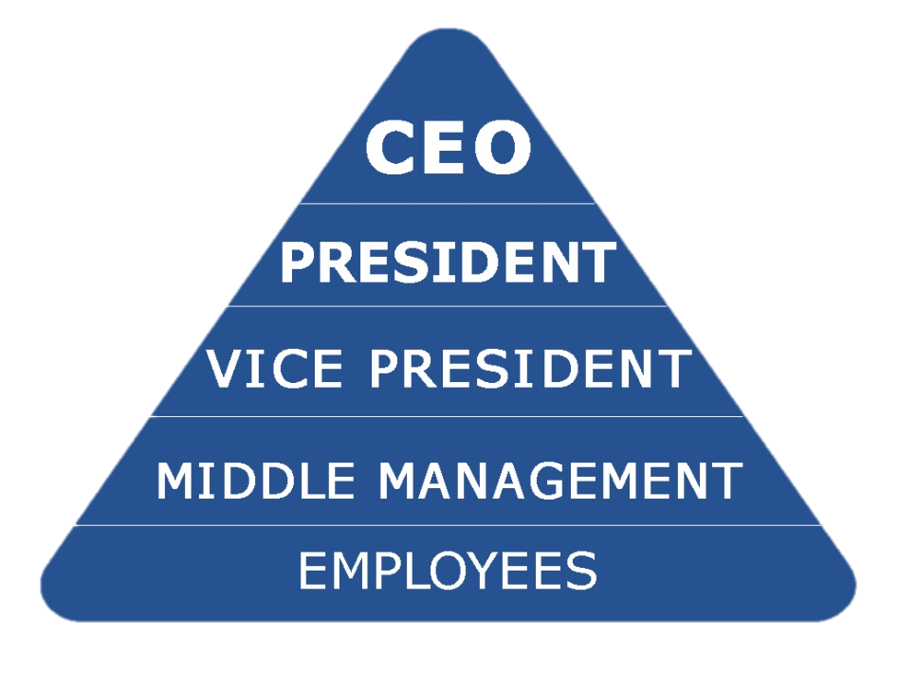
4 Keys to Changing the Culture
Mirror mirror. Talk honestly. Face the truth. Enable people to see that a change has to be made. (360 reviews are a great tool to see where you are at)
Create trust through transparency. Find ways to build a culture of trust so that people will entertain the plan for change. For example, share financial data, good and bad, within and across groups.
Invert the organizational pyramid. Make support functions and executives accountable to the frontline workers, rather than the other way around.
Recast the CEO’s role. Transfer the ownership of change from the office of the CEO to employees. Allow the CEO to ask as many questions as he answers.

Slide 11
3 Guiding Principles to Accountability Leadership
Long before leaders can develop plans for getting others to take on more responsibility and ownership for their work, they must set the foundation of accountability using these 3 guiding principles:
Clear and concise communications. A clear message helps people know what’s expected and how to make the right decisions.
Compelling consequences. Focus on consequences that produce positive outcomes, not consequences focused on punishing for doing something wrong.
Culture of accountability. Leaders set the tone for cultural norms. Mastering conversations that encourage accountability is how leaders exert a powerful influence on positive cultural change.

Slide 12
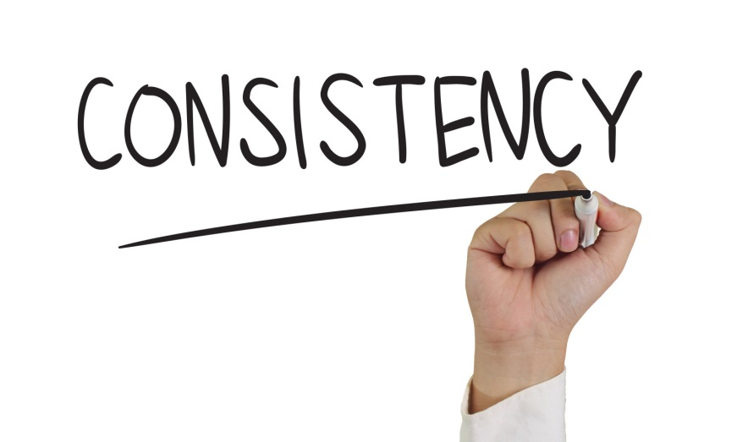
Leadership Communication
As a leader, everything you say and do takes on a greater meaning.
Your responsibility lies in using the power of your words and your actions to influence behaviors that bring about the right business results.
How you handle mistakes, blame, feedback and credit goes a long way to setting the stage for accountability.
Nothing is more important than consistently delivering your core message to employees.

Slide 13
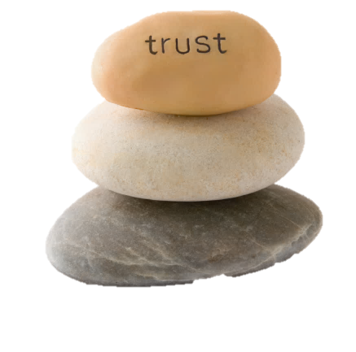
Building Trust
You build trust when you communicate your genuine interest in people and their needs.
While there are many factors that contribute to our perceptions of trustworthiness, here 3 key traits that you should focus on:
Character. Studies consistently cite honesty as the #1 attribute of effective managers – consistently doing what they say they’ll do.
Competence. Your managerial competency should not be measured by your technical skills, but by your ability to understand and influence people.
Caring. The most neglected trait is the ability to show you care. Employees want to feel they matter and their bosses actually care about them as people.
Only when these three traits are in place can employees reciprocate with trust.

Slide 14
4 Techniques to Building Trust
To improve your connection to your people and build trust, try these techniques:
Walk around. Walk around each day to touch base with individual contributors to our company’s success.
Capture vital statistics. Learn about each employee’s life: spouse’s name, children’s names and ages, major hobbies, etc.
Find what drives them. Explore each person’s guiding motivations.
Ask for ideas and feedback. Trust must already be established for people to be openly honest with you. Acknowledge that you have heard them and will think about what they have said.

Slide 15

Every conversation you have either builds trust or chips it away.

Slide 16
Positive vs. Negative Feedback
Studies show that positive feedback is more motivating than negative feedback.
Be careful of sandwiching a criticism between to positive comments. People will only remember the negative comment.
“That was a great presentation, Dale. Next time, don’t forget to include the graph data. I thought we discussed that. Other than that, it was very effective, nice work.”
Dale doesn’t hear the compliments, he only hears his boss was disappointed in him and wants to defend himself.
Managers who frequently recognize and celebrate small wins are those who bring out the best in their people.

Slide 17

The Power of Praise and Recognition
Positive reinforcement is a powerful source of fuel that energizes people to try harder, persist longer and overcome difficulties.
When we receive praise, our brain releases dopamine, a neurotransmitter that stimulates the pleasure centers.
Gallup Survey shows that individuals who receive regular recognition and praise:
Increase their individual productivity.
Increase engagement among their colleagues.
Are more likely to stay with an organization.
Receive higher loyalty and satisfaction scores from customers.
Have better safety records and fewer accidents on the job.
Nothing has greater impact on an employee than when recognition comes from their direct supervisor.

Slide 18
How to Give Feedback
Ask for permission to give feedback.
“Hey, do you have a minute for some quick feedback?”
State what you observed.
“After work yesterday, I noticed that you didn’t help the rest of the crew do clean-up.”
Don’t say: “After work yesterday, I noticed you were being lazy.”
Explain the impact.
“When you explained our return policy to the customer it looked like she became more irate.”
Don’t say: “I noticed you pissed off the customer.”
Pause and ask for the other person’s reaction.
Suggest concrete next steps. Give one or two actionable suggestions that the other person can take in the future to improve this outcome.

Slide 19


When people are motivated by inspiration, to a cause greater than themselves, their behavior is deeply personal. They are committed and engaged to help and participate.

Slide 20
How Do You Motivate Employees?
Psychologist Frederick Herzberg – One of our greatest motivators at work is our need for achievement and recognition.
Motivate staff by providing opportunities for growth and education that lead to a sense of mastery and achievement.
Create optimal conditions:
Clear goals and expectations
Challenging goals that stretch one to bring out their best work.
Immediate and consistent feedback and recognition of progress.
Anything you can do to help employees enjoy a greater sense of freedom and control at work will increase their level of motivation.

Slide 21
Incentive Plans Don’t Work
Rewards alone do not create a lasting commitment. Rewards only change what people do in the short term.
Rewards motivate people to get rewards.
People will focus on doing what is necessary to win, not on the purpose of the work itself.
Studies have shown rewards typically undermine the very processes they are intended to enhance.

Slide 22
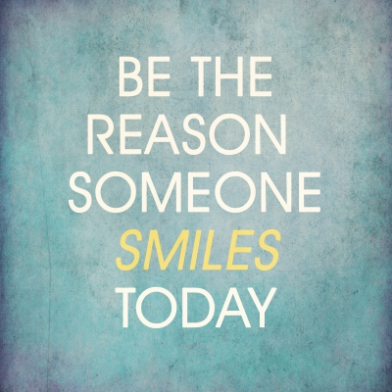
Your greatest source of power for creating compelling consequences is your ability to change how people feel.

Slide 23
Compelling Consequences
Write down all the consequences you know of - both negative and positive - that you use to motivate employees.
Compensation
Bonuses
“Thanks”
Privileges
Status/title
Time off
Termination of service
Loss of privilege
Disciplinary Action
Now think about losing a valuable employee, one of your stars. What would she say would be the reasons she would never accept a job offer at higher pay? What are the emotions you imagine would be on her list of reasons to stay?

Slide 24
Compelling Consequences
Make a list of all the ways you could influence or change the way someone feels about their job.
Acceptance
Public recognition
Responsiveness to request
Time and attention
Inclusion in decisions and activities
Privileges including information
Familiarity
Acknowledgement in public
3rd party compliments
Partnering with them
Staying out of their way
Visibility
Free time
Freedom to fail, experiment
Realize you have a tremendous capacity to change the way people feel and it has nothing to do with a carrot on a stick or the fear of god.

Slide 25
How To Motivate Employees?
Use emotional rewards.
Ask what makes them feel good at work. They’ll probably give you some good ideas that work for motivating them.
What are things you want to encourage more of?
Match these up with appropriate emotional rewards.
What are the things you no longer want to tolerate?
Take positive consequences away creating negative consequences for behaviors you want to discourage.
People are twice as sensitive to a loss as they are to a gain. Taking away a privilege or a task can be a powerful negative consequence.
You can withdraw assignments, information, autonomy and attention.
You can start limiting your time with them.
You can restrict access to resources.

Slide 26


Consequence Timing
Small and frequent feedback improves well-being more than massive rewards at a distant date.
Bring your consequences close to the actual performance.

Slide 27

Everybody’s Different
Everybody is motivated – just not by the same things.
Understand what is motivating your people, so you can show them how things you want them to do are in their own best interest.
To do this, you need to have conversations and explore their needs.

Slide 28
The question a manager needs to ask themselves is not
“How do I get people to serve the company?”
but rather,
“How do I create a work environment and a sense of purpose that literally merits the gifts of creativity and passion?”

Slide 29
Guiding Principles – Ask Yourself
Clear Messages:
Am I communicating clearly, reminding myself and others of our mission, values and strategy?
Do I relate the big picture to real world situations, people and business realities?
Am I connecting the dots to small daily tasks and goals?
Am I generous with recognition and praise?
Consequences:
Do I have compelling consequences in place that encourage people to use their strengths and creativity?
Do I discourage behaviors that distract while encouraging fun and friendships?
Do I encourage problem solving in new ways?
Do I let people come up with their own ideas?
Do I recognize achievements personally?
Conversations:
Do I give feedback in a manner that can be received?
Do I focus on behaviors without being judgmental?
Do I allow people the chance to express themselves without interrupting them with my solutions?
Do I act like I’m open to hearing about mistakes and other opinions?
Do my conversations build trust?

Slide 30
Compelling Consequences – Ask Yourself
Do my people know what’s at stake for the organization?
Do my people know why their jobs matter?
Do I know something about why each person’s job matters to them?
Do I offer clear goals that encourage people to use their strengths and creativity?
Do I discourage behaviors that distract them from their goals?
Do I encourage fun and friendships?
Do I encourage problem solving in new ways?
Do I let people come up with their own ideas?
Am I accepting mistakes, and do I work on turning them into learning opportunities?
Do I recognize achievement personally and immediately?
Am I providing clear negative consequences for bad behavior?
Do I follow up with people regularly, offering attention for small wins and progress?

Slide 31
Wrap-Up
Adopt traits of a good leader to promote employee empowerment. To empower your employees, you have to be a role model.
Delegate tasks clearly and concisely. Make sure there are no gray areas when assigning specific duties to specific employees. That way, employees will know exactly what is expected and there will be no room for passing the buck.
Give up some of your power in favor of employee autonomy. This makes their work feel more exciting and rewarding, since they’ll feel like they have more of a say in the work they do.
Be friendly without being a friend. Though you should avoid being that “cool boss” who is too friendly with all of his employees, it doesn’t hurt to smile at your employees, make small talk to show you care about them on an individual basis.
Be respectful. To motivate employees, you have to respect them as human beings and employees.
Be positive. To be a good leader, motivate your employees with a positive attitude and environment.
Acknowledge employee achievements. Make it a point to frequently cite successes and to verbally congratulate employees on a job well done.
Open your door to employees. An important part of empowering employees is letting them know their opinions are valuable.

Slide 32
Wrap-Up cont.
Give more compliments than criticism. Though criticism is helpful if given correctly, you should focus on all of the good things that your employees are doing instead of nitpicking them and making them feel like “no news is good news.”
Criticize constructively. You can’t succeed in your job if you never criticize your employees, but when you explain something they’ve done incorrectly, make sure you do so in a respectful manner.
Understand what motivates each employee. To empower employees, know what makes them tick. They won’t all be motivated by the same thing, so if you want them to succeed, you have to know their strengths and weaknesses to make the most of their abilities.
Make employees feel like they are part of the company. To empower employees, you have to make them feel like what they do for the company really does matter and impacts its success.
Show employees there’s room for growth in the company. To empower employees, make sure they have a clear path to success and that they feel recognized as they get better and better at their jobs.
Be willing to do what you ask them to do. Then stand “shoulder to shoulder” with them assisting them with the task; this helps to build your respect as a leader.
Make the workplace a welcoming environment. Another way to empower your employees is to make your workplace a fun and friendly place to work.

Slide 33
QUESTIONS?

